Slide 1
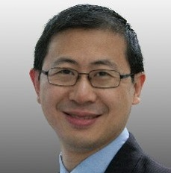
Trends in Color Management
William Li
Color Technology Manager
Notes:
Thank you all for getting up at this hour in the morning to talk about color. Though I suppose, given that I flew in from the Left Coast last night, perhaps I should just be thanking myself for being awake at 5:30 in the morning.
Before I begin, I’d like to get a quick sense of where everyone’s coming from here. How many printers? Design? Other?

Slide 2
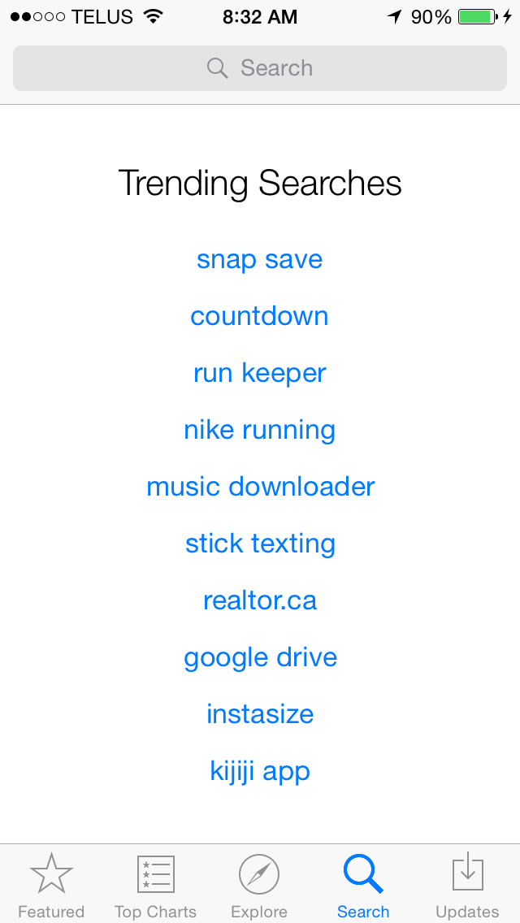
Trending…
Notes:
Trending is all about following what everyone else does, and hoping that if you follow the herd, you might find something interesting to you, or get a warm feeling in the cockles of your heart if you’ve already, for example, downloaded Run Keeper, which is a cool little app that helps you figure out how much and where you’ve been running.

Slide 3


Trends
Notes:
When you follow a trend, that’s exactly what you’re doing – following. There is no leading involved. On the other hand, if you’re the person in front, then hopefully you know where you’re going. If you’re leading, it helps to have an understanding of the lay of the land, so you know where the places are where you might go. It also helps to know why you’re running; that way you can make choices about where to go that make sense for you. If you don’t get a good grasp of that, you can easily lose your way even if you have a good grasp of the geography.

Slide 4

Forward and Back
Notes:
So what I don’t want to do is talk about the next big thing, or what we’re on the cusp of, or any sort of crystal ball gazing like that, though there is some very interesting stuff happening out there.
What I’d like to do is back the truck up a little and talk through a couple of important ideas about color and management, to give us some context for what’s driving the development of color management today. By analogy to stock trading, call it an analysis of the fundamentals.

Slide 5
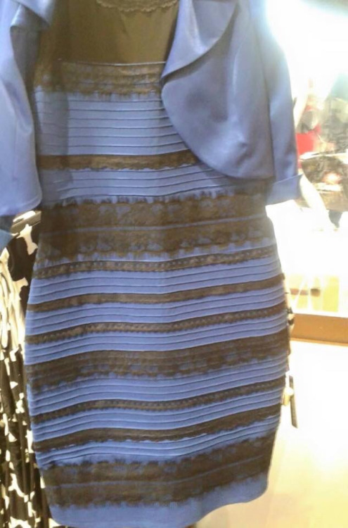
Color?
Notes:
We, all of us here, work in color not just because it lets us participate in the Internet meme of the day. We all know there’s a lot more at stake than that, otherwise you all wouldn’t be here today.

Slide 6

Color Facts
People make a subconscious judgment about an environment or product within 90 seconds of initial viewing. Between 62% and 90% of that assessment is based on color alone.
Color:
  Improves brand recognition by up to 80%
  Increases comprehension by up to 70%
  Makes ads read up to 42% more often
  Makes an impression that’s 40% more memorable
Sources: Xerox Corporation and International Communications Research from February 19, 2003 to March 7, 2003

Slide 7
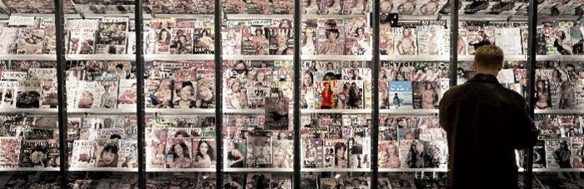
Notes:
Color and appearance can attract the eye and make your product stand out from the crowd when done right. That’s what’s driven interest in things like extended process, GRACoL Plus, and metallics, in many areas of printing.

Slide 8
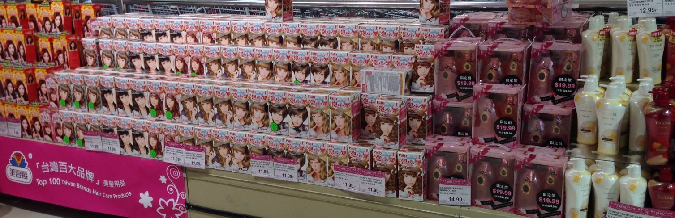
Notes:
And in displays like this one, color consistency is king. The product box which is different in color will be the product which does not get bought and turns into waste and a cost item for the CPC.

Slide 9

Color Communication
Notes:
At its heart, color is part of how we communicate. Color management is how we ensure that what our clients say is what they mean, that what they get is what they need.
Take away all the technology tools and approaches, and you’ll find that the people, the actors involved in our little color drama have evolved much more slowly than the technology. The successful – trends, if you will – the good ways to go, all keep this in mind, that people with human motivations are behind all that we do.

Slide 10

Motivation
Notes:
The other thing behind what we do, of course, is this.
There are 2 ways to improve your bottom line. One is to cut costs, so that for a given top line, you have more left over when the day is done. I think we’ve all lived what that means. And yes, color management has had a role to play here, improving efficiencies in operations. Some of what’s going on right now plays very much to that.

Slide 11
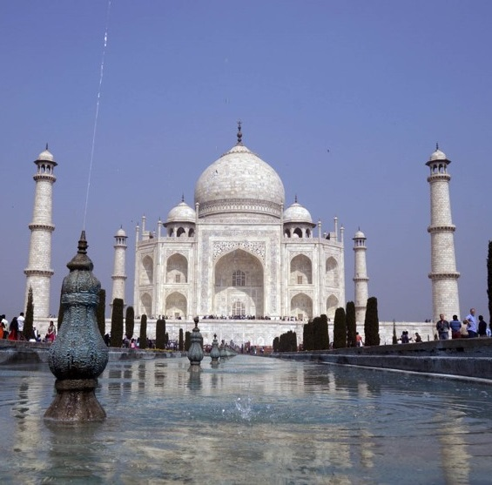
Top Line
Volume
Price
Customers
Notes:
There are 3 ways to improve your top line.
One is pound the pavement, virtual or otherwise, and just get more customers and increase your volume. Everyone’s shaking their heads at this point – if it were that easy, everyone would be doing it, right?
The second is to increase price; carefully, of course, as the laws of supply and demand are still at work. This is the concept from economics called elasticity, the slope of the curve. This is the strategy the banks and airplane companies have adopted, counting on low elasticity.
The third is to make your customers more profitable, because if they’re more profitable, they can afford to buy more print – whether magazines or cartons – and they can probably afford to pay more per unit.
India story about view on print market.

Slide 12
Color Forces
Standardization & Globalization
Extended gamut
Managed color

Slide 13
Useful Standards
Viewing | ISO 3664
Observer | ASTM E1499
Instrument | ISO 13655, SCHMOO
File Format | ISO 15930 – series (PDF/X-4) 1.7
Pre-Flight | GWG-v4 2012 www.gwg.org
Paper/Substrates | ISO 15937
Proofing | ISO 12647-7/8, ISO 12646, ISO 14861
Workflows | ISO TS 10128 / CGATS.21
Printing | ISO 12647 series
Inks | CxF/x-4, ISO 17972-4
Process Control | ISO 12647 & ISO 16761 draft - series
Notes:
Reasons to use standards:
Consistency, run to run, place to place
Ease to get job done

Slide 14
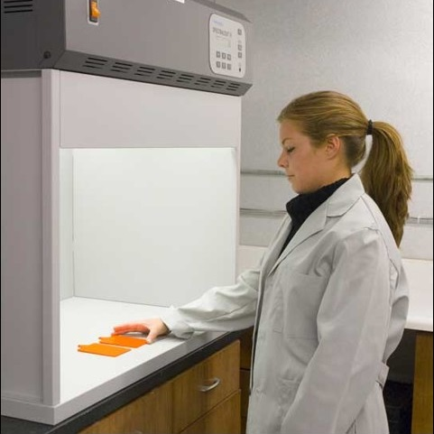
M etc.
M0: legacy
M1: defined UV: D50
M2: UV-excluded
M3: polarized
Notes:
ISO 3664, 13655
ISO 12646, 14861

Slide 15

Print Aims & Globalization
Notes:
G7, Fogra…

Slide 16

ISO TC130
Join up to make Canada a P-member!

Slide 17
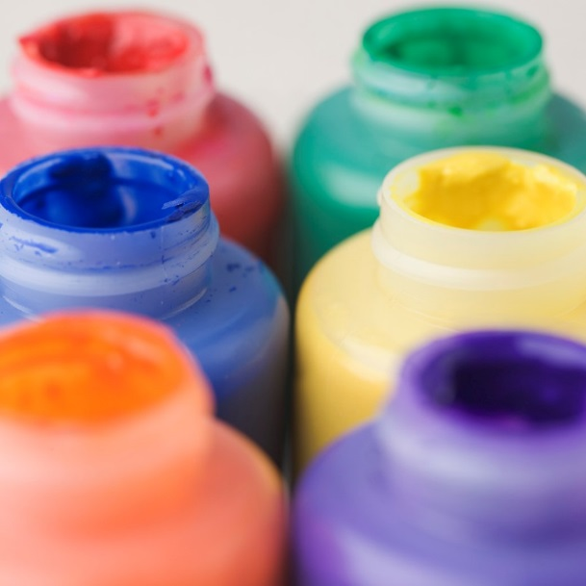
Extended Process Printing
More than just colours!
Notes:
More than just more colors, so not just extended gamut

Slide 18
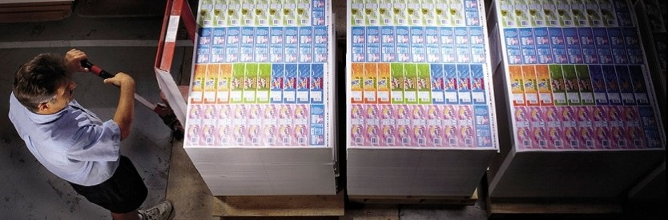
Benefits
Notes:
Ink stays in press. Makeready, ganging.
Like “digital press”

Slide 19

RGB wide gamut separation
Spot color replacement
Extended Process Workflow

Slide 20

GRACoL Plus
Leveraging print stability of FM screening to allow increased CMYK print densities.
Use G7, color management as needed.

Slide 21

iccMAX
iccMAX takes off where v4 ends…
2 related but different profile formats.
iccMAX
v4
Notes:
Just what are v4 and iccMAX to each other?

Slide 22
v4
Strengths
Limitations
Graphic arts workflows
Consistency & Ubiquity
Speed
D50 PCS
Colorimetric PCS
(lack of handling for) OBAs
(lack of) Metameric resistance
(assumption of) Spatial uniformity

Slide 23
iccMAX Key Areas
Lighting
  Non-D50
  Fluorescence
Materials
  Spot colors
  Spectral handling

Slide 24

Management of Colour

Slide 25
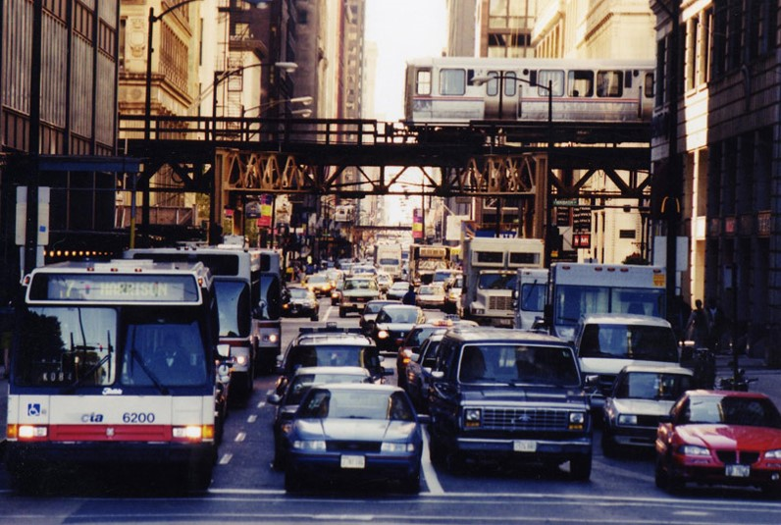

Slide 26
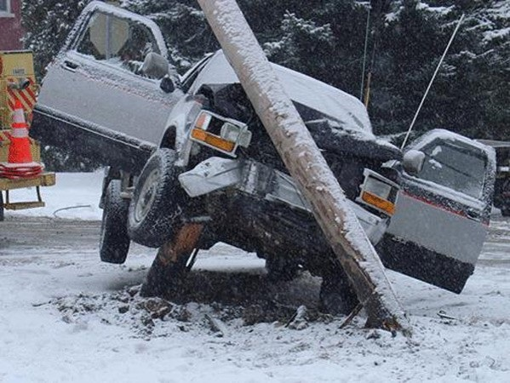
Avoid this!

Slide 27


